Slide 1
Biomedical Instrumentation PPG
Miodrag Bolic

Slide 2
Scope
Oxygen saturation
PPG system model
Pulse oximeters
Simulations
Processing
Current solutions

Slide 3
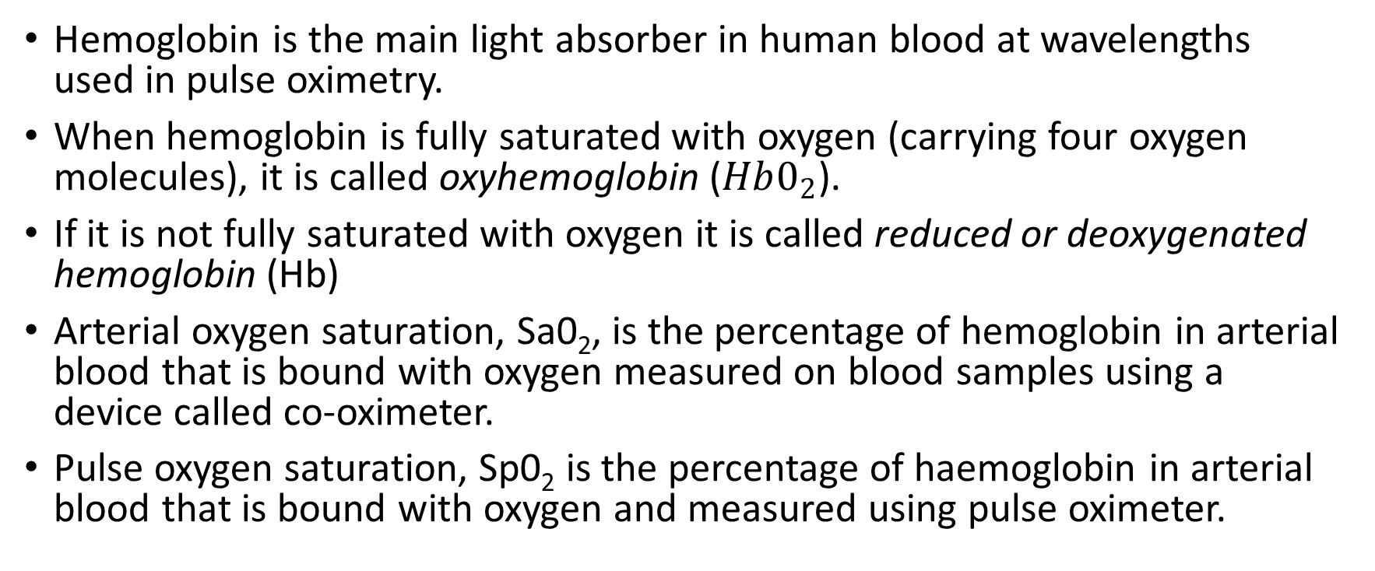
Oxygen saturation
Hemoglobin is the main light absorber in human blood at wavelengths used in pulse oximetry.
When hemoglobin is fully saturated with oxygen (carrying four oxygen molecules), it is called oxyhemoglobin ($Hb0_{2}$).
If it is not fully saturated with oxygen it is called reduced or deoxygenated hemoglobin (Hb)
Arterial oxygen saturation, Sa0₂, is the percentage of hemoglobin in arterial blood that is bound with oxygen measured on blood samples using a device called co-oximeter.
Pulse oxygen saturation, Sp0₂ is the percentage of haemoglobin in arterial blood that is bound with oxygen and measured using pulse oximeter.

Slide 4
Photoplethysmography
Photoplethysmography (PPG) is a non-invasive optical technique that is used to detect blood volume changes in the blood vessels.
In the transmittance mode the photodetector and LED are on the opposite sides of the tissue that is illuminated and the light is transmitted through the tissue.
In reflectance mode, the photodetector and LED are on the same side of the tissue and the origin of the detected signal is from the scattered and reflected light.

Slide 5
AC and DC component
Out of the light that is collected by the photodetector, about 98% to 99% is the DC component that does not change during the cardiac cycle.
DC component of the light is caused by venous pulsation that are very weak and scattering and reflections from all other tissue but arterial blood.
AC component of the pulsating change is caused mainly by arterial filling during the systole based on the original definition of PPG.

Slide 6
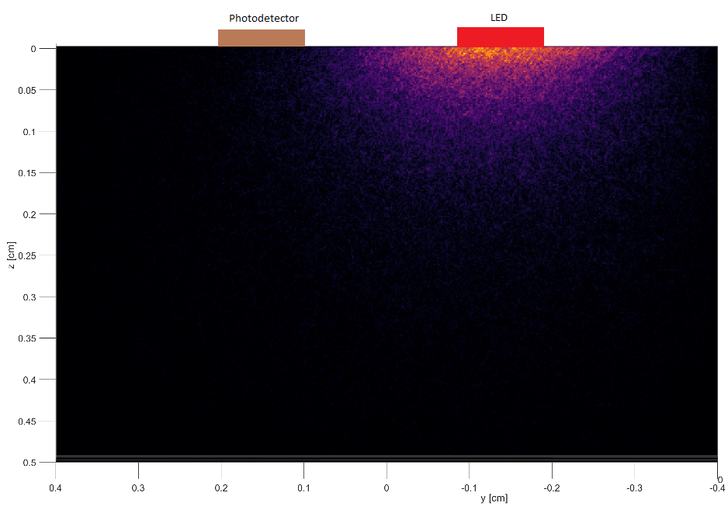
Normalized fluence rate and AC components
Fluence Rate F [W/$cm^{2}$] refers to the power P that irradiates surface area A which is incident from all angles onto a small region of space.

Slide 7
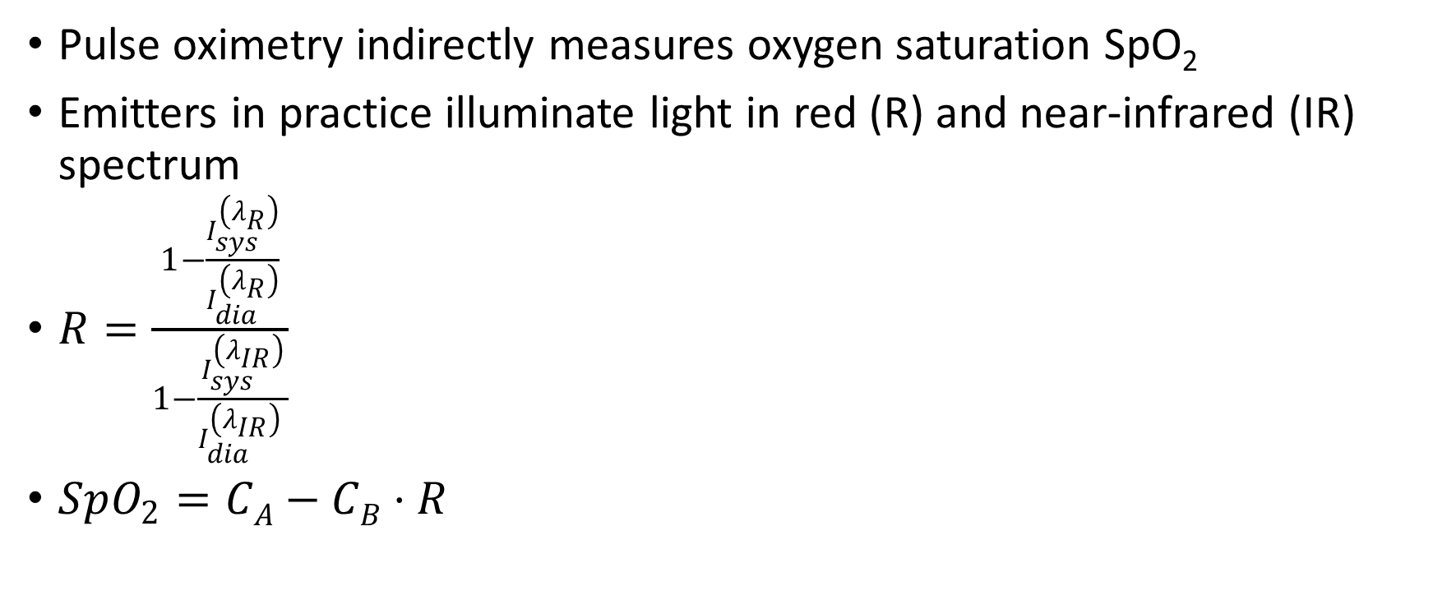
Pulse oxymeter
Pulse oximetry indirectly measures oxygen saturation SpO₂
Emitters in practice illuminate light in red (R) and near-infrared (IR) spectrum
$R=\frac{1−\frac{I_{sys}^{\left(λ_{R}\right)}}{I_{dia}^{\left(λ_{R}\right)}}}{1−\frac{I_{sys}^{\left(λ_{IR}\right)}}{I_{dia}^{\left(λ_{IR}\right)} }}$
$SpO_{2}=CA−CB⋅R$

Slide 8
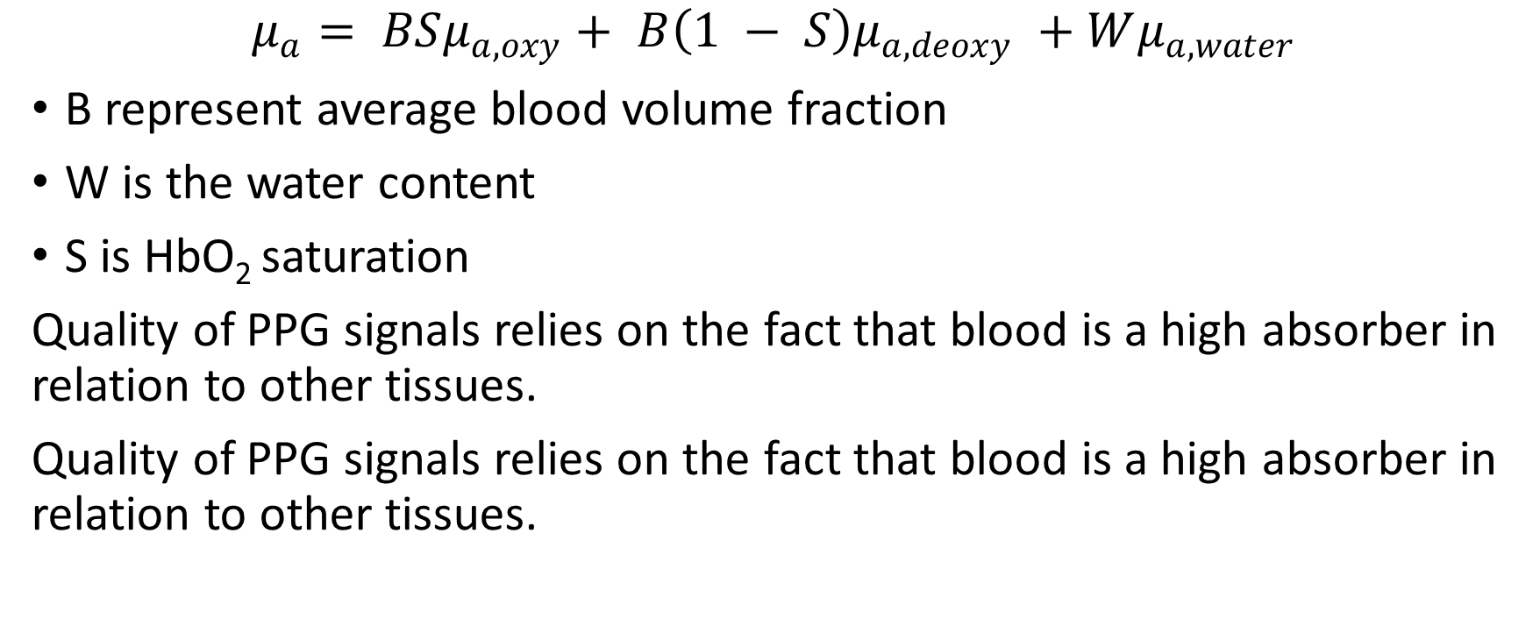
Absorption coefficient
$$\begin{aligned}μ_{a}= BSμ_{a,oxy}+ B\left(1 − S\right)μ_{a,deoxy} +Wμ_{a, water}\end{aligned}$$
B represent average blood volume fraction
W is the water content
S is HbO₂ saturation
Quality of PPG signals relies on the fact that blood is a high absorber in relation to other tissues.
Quality of PPG signals relies on the fact that blood is a high absorber in relation to other tissues.

Slide 9
Absorption coefficient vs wavelength

Slide 10
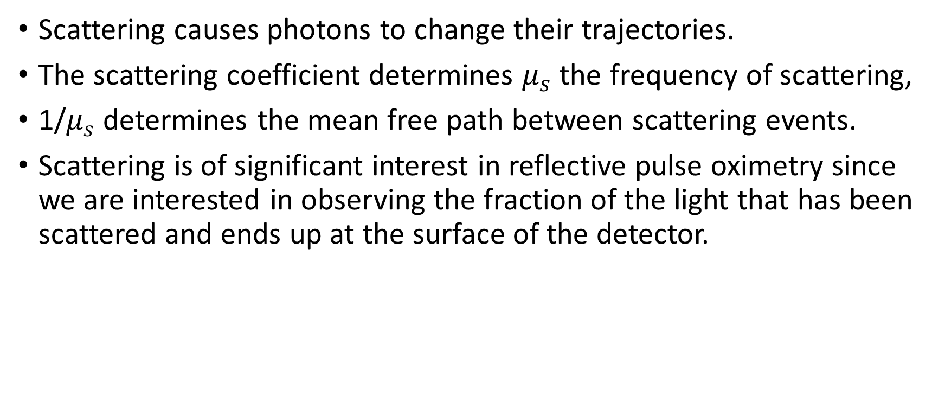
Scattering
Scattering causes photons to change their trajectories.
The scattering coefficient determines $μ_{s}$ the frequency of scattering,
1/$μ_{s}$determines the mean free path between scattering events.
Scattering is of significant interest in reflective pulse oximetry since we are interested in observing the fraction of the light that has been scattered and ends up at the surface of the detector.

Slide 11
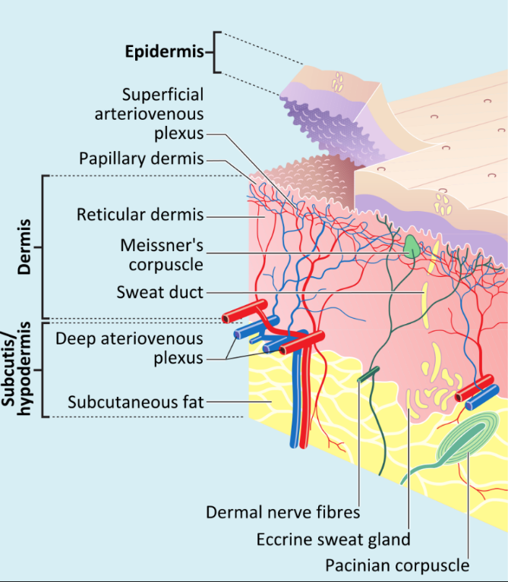
Layers of human skin

Slide 12
PPG signal
The signal can be corrupted in different ways due to ambient light, 60 Hz interference, motion artifacts
Motion artifact is commonly observed as changes in the airgap between the emitter/detector and the skin

Slide 13
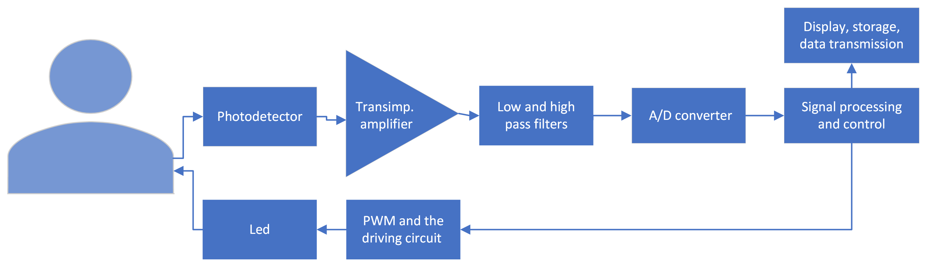
PPG system model

Slide 14
Driving LEDs
Voltage-current characteristics of and LED implies that small variations in the forward voltage cause large fluctuations is forward current and therefore in the radiant power. Therefore, LEDs are commonly driven using current sources
LEDs can be switched on and off at a high rate and they are not commonly turned on all the time. If the LED is switched on only a small percentage of time, then this will reduce the power consumption of the device significantly.
Pulse width modulation
PWM frequency
Pulse width offset
Output voltage

Slide 15
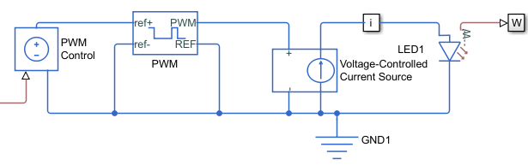
Driving LEDs

Slide 16
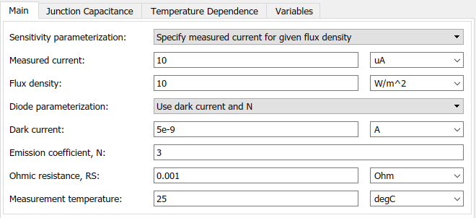
Photodiode input
Radiant power of LED was is 1 mW
The illuminance fraction is considered to be 2 % based on simulations.
Area of the photodiode is considered to be 4 mm².
Irradiance: 0.02⋅1mW/4mm²=5W/m².
The current through the photodiode is 5 µA

Slide 17
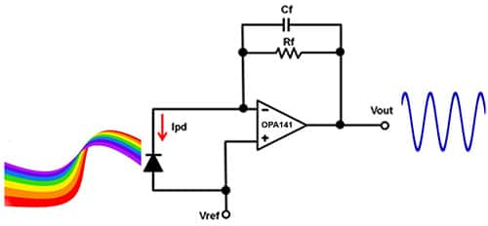
Transimpedance amplifier
Transimpedance amplifier converts the current generated by the photodiode into voltage
Notes:
Image from https://www.digikey.ca/en/articles/how-to-design-stable-transimpedance-amplifiers-automotive-medical-systems

Slide 18
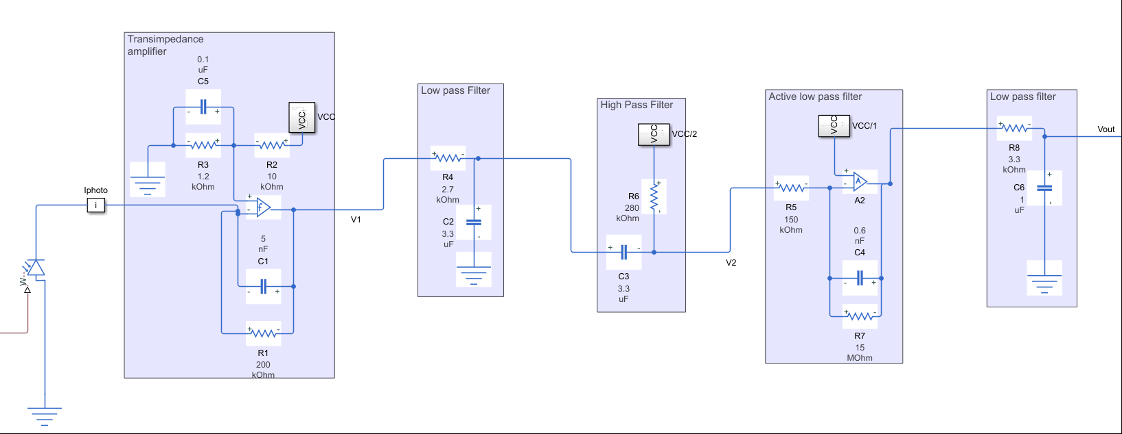
Processing photodiode signal in PPG systems

Slide 19
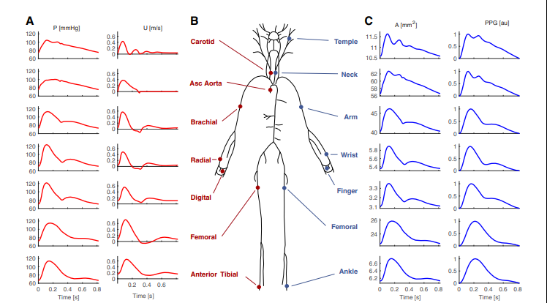
Pulse morphology at different sites

Slide 20
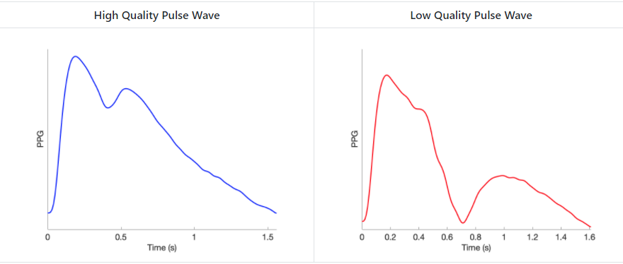
Signal quality indicators
Notes:
From https://github.com/peterhcharlton/pulse-analyse/wiki/Examples

Slide 21
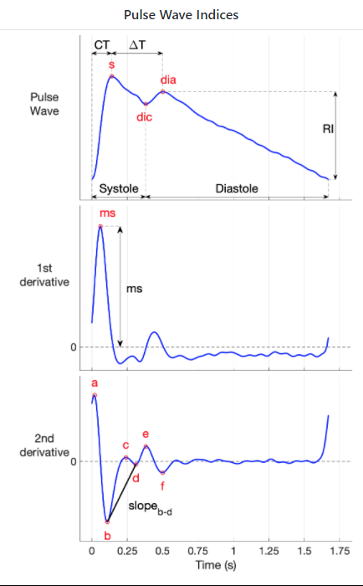
Processing
Baseline shift removal
Filtering
Extracting fiducial points and pulse wave indices
s: the systolic peak
dia: the diastolic peak
dic: the approximate location of the dicrotic notch
CT: the crest time
ΔT: the time between systolic and diastolic peaks
Systole: the approximate duration of systole
Diastole: the approximate duration of diastole
RI: the amplitude of the diastolic peak
Notes:
https://github.com/peterhcharlton/pulse-analyse/wiki/Examples

Slide 22
Tools for analysis pulse waves
Databases
Simulated and invivo: https://peterhcharlton.github.io/pwdb/datasets.html
Mimics III
Simulators
Light propagation: MCMatlab
Pulse morphology at different sites:
Algorithms
https://peterhcharlton.github.io/pulse-analyse/index.html

Slide 23
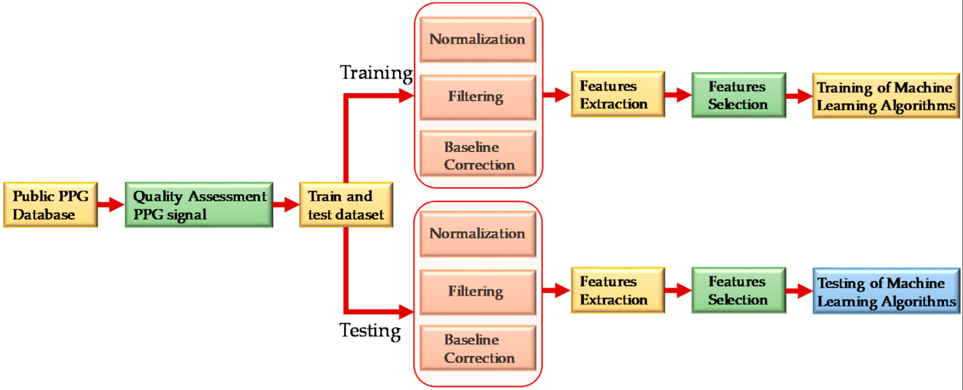
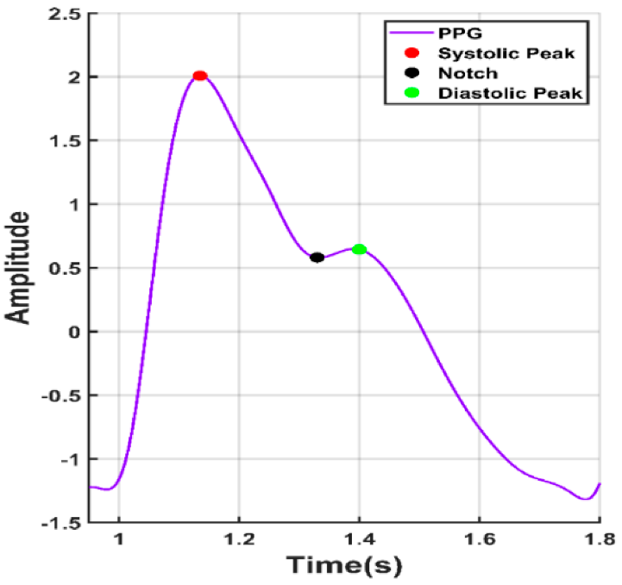
Estimating blood pressure based only on PPG
Notes:
From https://www.mdpi.com/1424-8220/20/11/3127/htm

Slide 24
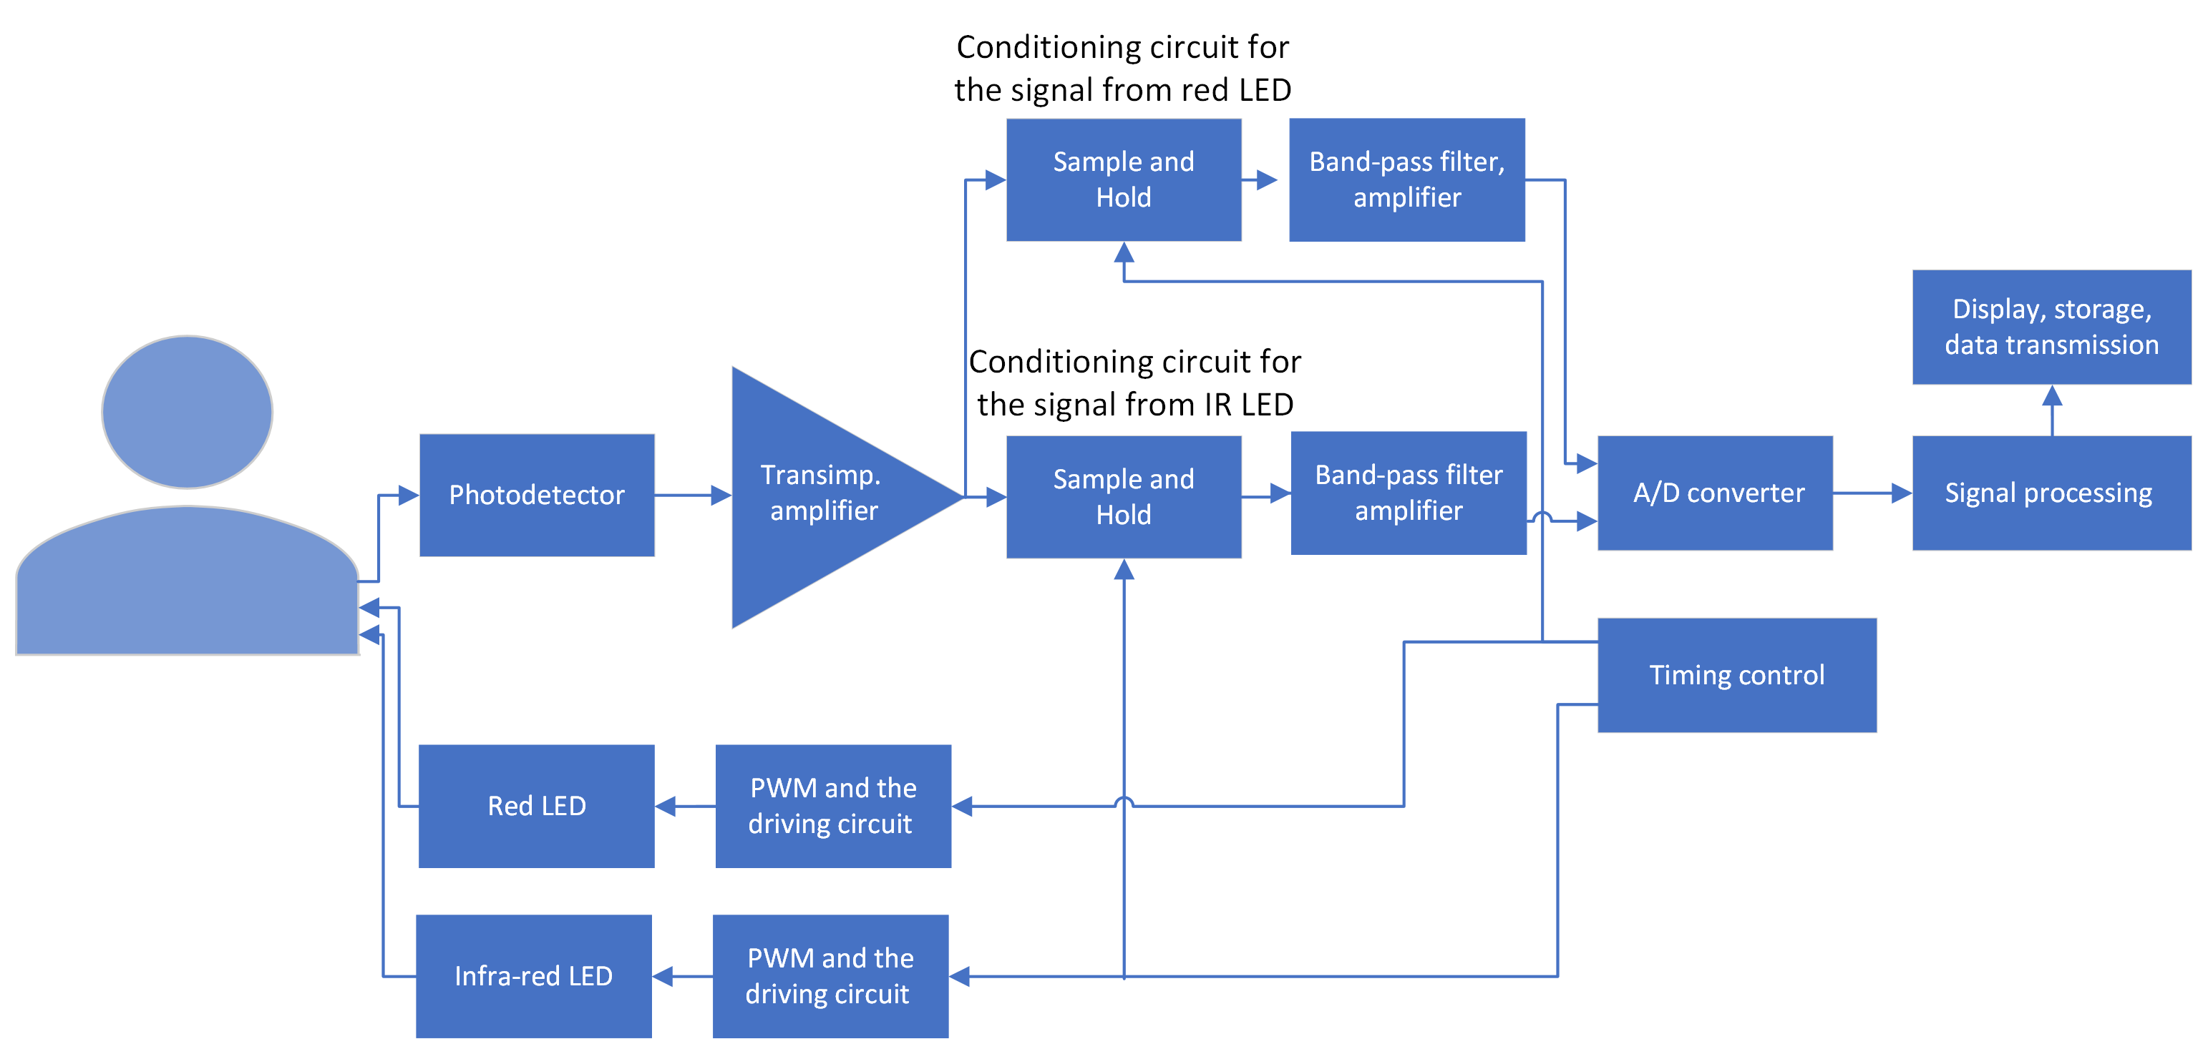
Pulse oximeter circuit

Slide 25
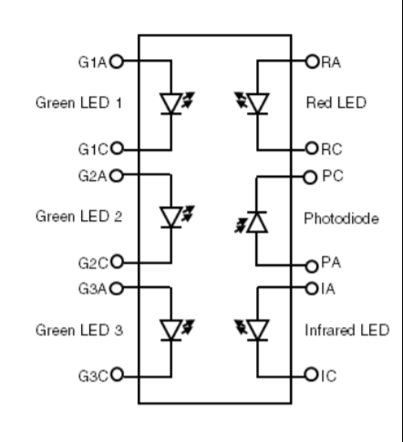
Commercial solutions
Integrated front end – require only LEDs and photodetectors to be added, e.g. TI AFE4403
Integrated LEDs and photodetectors, e.g. Osram OptoSemiconductors SFH7060
Completely integrated pulse oximeters
Integration with other sensors

Slide 26
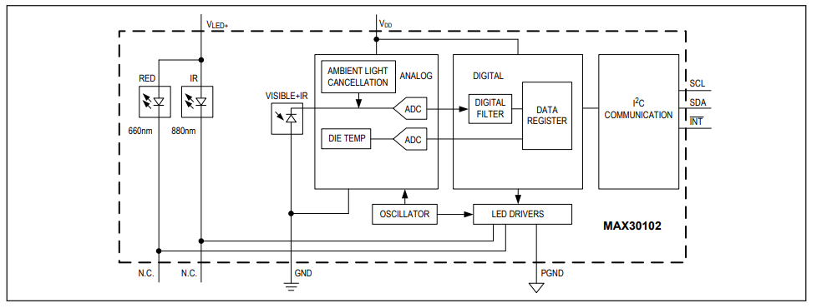
Commercial solutions – Single chip MAX30102
Notes:
https://datasheets.maximintegrated.com/en/ds/MAX30102.pdf

Slide 27
Commercial solutions – Single chip MAX30102 (cont.)
Heart-Rate Monitor and Pulse Oximeter Biosensor in LED Reflective Solution
Tiny 5.6mm x 3.3mm x 1.55mm 14-Pin Optical Module
Integrated Cover Glass for Optimal, Robust Performance
Ultra-Low Power Operation for Mobile Devices
Programmable Sample Rate and LED Current for Power Savings
Low-Power Heart-Rate Monitor (< 1mW)
Ultra-Low Shutdown Current (0.7µA, typ)
Fast Data Output Capability
High Sample Rates
Robust Motion Artifact Resilience
High SNR

Slide 28
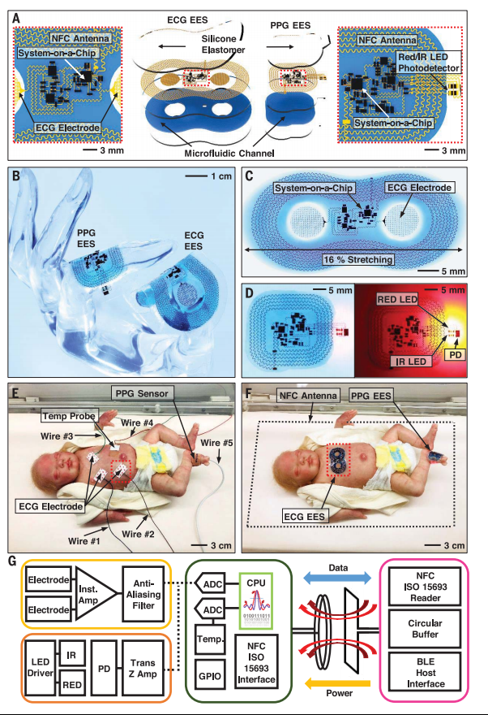
Research
Notes:
https://science.sciencemag.org/content/sci/363/6430/eaau0780.full.pdf

